Slide 1
SBERBANK RUSSIAN HOUSING MARKET
CAN YOU PREDICT REALTY PRICE FLUCTUATIONS IN RUSSIA’S VOLATILE ECONOMY?

Slide 2


The Source of Data
Sberbank started a competition on Kaggle to predict housing price in Russian market.
The training data is from August 2011 to June 2015, and the test set is from July 2015 to May 2016.
The dataset also includes information about overall conditions in Russia's economy and finance sector.

Slide 3
Feature list and their descriptions
In our training data there are approximately 30.5 k houses and 292 features. The important features are listed below.
price_doc: sale price (this is the target variable)
id: transaction id
timestamp: date of transaction
full_sq: total area in square meters, including loggias,
balconies and other non-residential areas
life_sq: living area in square meters, excluding loggias,
balconies and other non-residential areas
floor: for apartments, floor of the building
max_floor: number of floors in the building
industrial_zone_km: Distance to industrial zone
green_zone_km: Distance to green zone
park_km: Distance to park
area_m: Area mun. area, sq.m.
material: wall material
build_year: year built
num_room: number of living rooms
kitch_sq: kitchen area
state: apartment condition
product_type: owner-occupier purchase or investment
sub_area: name of the district
full_all: subarea population
metro_: subway
metro_min_avto: Time to subway by car, min.
kindergarten_km: Distance to kindergarten
school_km: Distance to high schoo
radiation_km: Distance to burial of radioactive waste

Slide 4
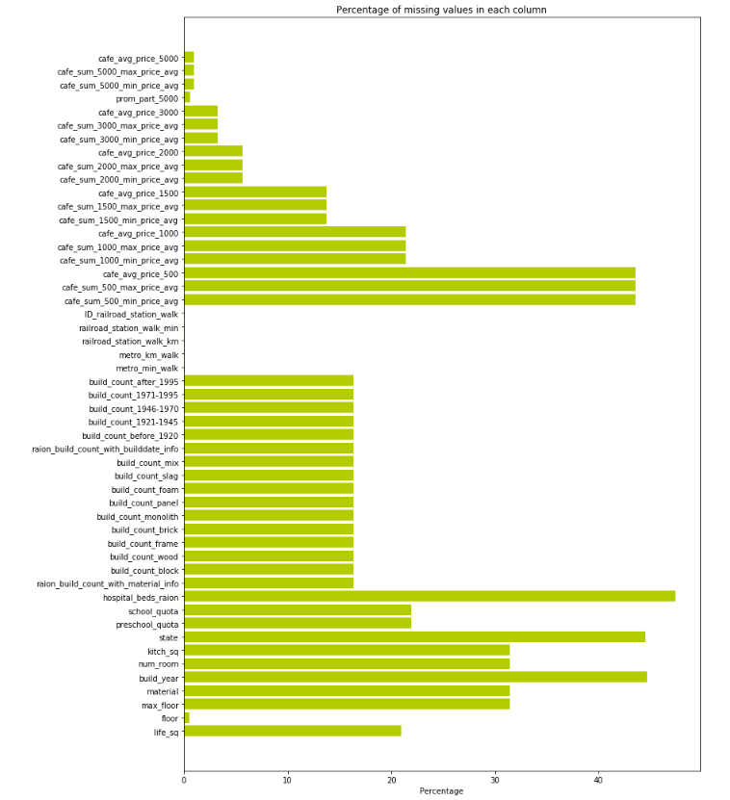
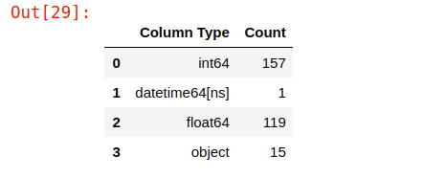
Statistical Exploration of Features
In our training data, we have 15 categorical variables, 276 numerical variables, 157 of them are integers and 119 are floating. Finally, we have 1 time variable - datetime object.
Percentage of NA values for each column. A lot of variables missing with their groups.

Slide 5
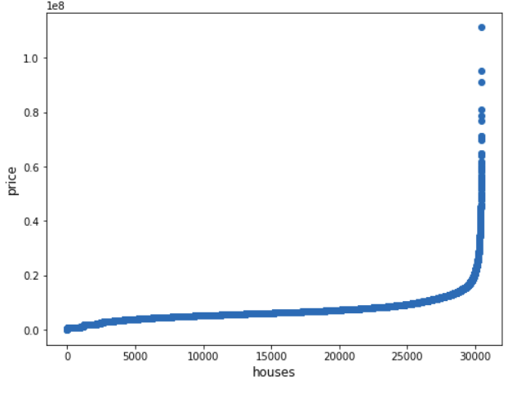
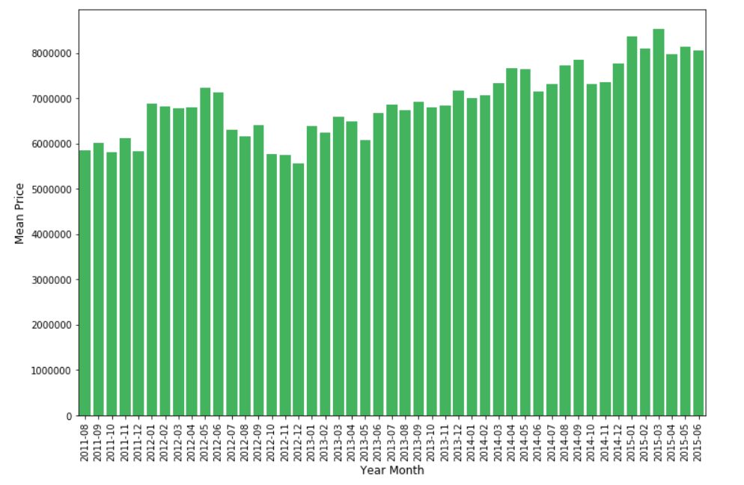
Statistical Exploration of Features
To detect outliers, we plotted our target variable “price_doc”.
Then, we created a feature that shows monthly mean prices of houses. There is an increase in house prices by time.

Slide 6
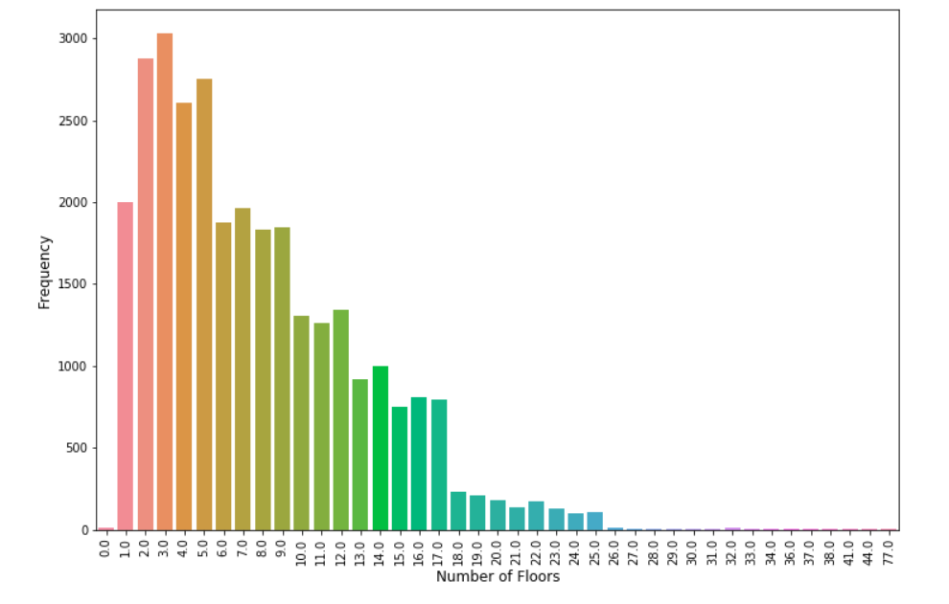
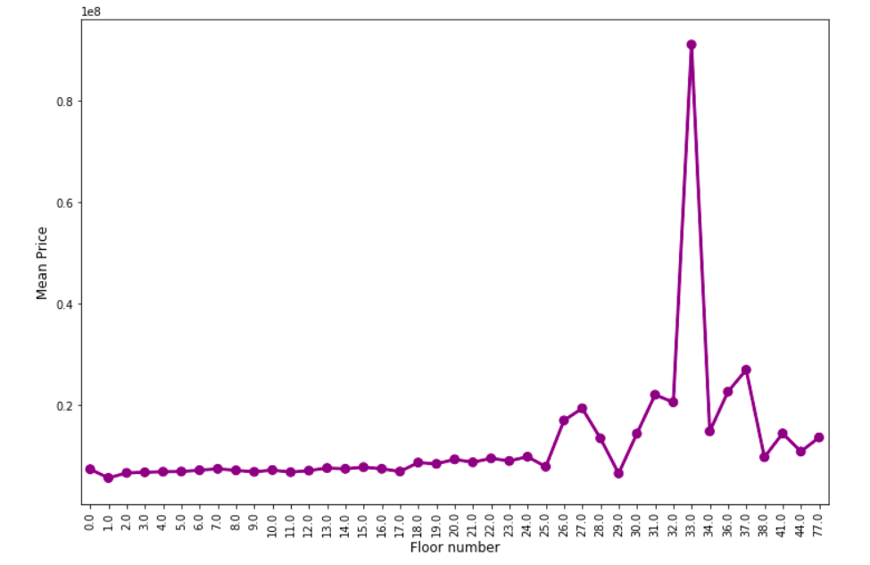
Statistical Exploration of Features
The pilot below shows the counts of the floor numbers. Most of the buildings are in the second third floor.
This shows an overall increasing trend. A sudden increase in the house price is also observed at floor 18. Also the houses with 0 floor are more expensive.

Slide 7
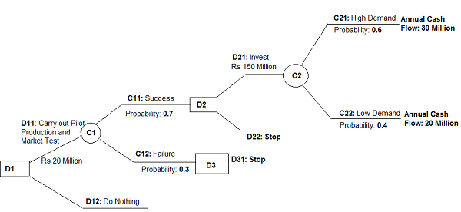
ML method or methods you are going to employ and details about them
A decision tree is a decision support tool that uses a tree-like model of decisions and their possible consequences, including chance event outcomes, resource costs, and utility. It is one way to display an algorithm that only contains conditional control statements.
Decision trees are commonly used in operations research and operations management. If, in practice, decisions have to be taken online with no recall under incomplete knowledge, a decision tree should be paralleled by a probability model as a best choice model or online selection model algorithm.

Slide 8
How you are going to employ ML method
As seen, there is so much parameter at determining house prices. However, some feature are more than others. To determine which features are important, we use XGBoost.
After that, we are going to use Decision Tree Regressor which we found most proper ML algorithm to predict house price by our research.
Decision Tree Regressor divide data into branches and after that it apply regression to each node of tree. When we want to predict a house price, first the model locate the datapoint to proper node and after that apply regression to predict prices. There are some cons about Decision Tree Regressor such as it naturally give range of prices not exact price. However, insights from the model are valuable to see what is going to happen in the market.

Slide 9
Thanks...
Baran Berkay Barakçin
Murat Baki Bozat
Ege Baştürk
Ahmet Burak Çakmak
Emre Tunçay
Mustafa Yıldırım

